Slide 1
Performance Comparison for Data Retrieval from NoSQL and SQL Databases: A Case Study for COVID-19 Genome Sequence Dataset
- Soarov Chakraborty, Shourav Paul, K. M. Azharul Hasan
Department of Computer Science and Engineering ,Khulna University of Engineering & Technology ,Khulna-9203, Bangladesh
Ayush Singh
1911058
SY COMPS A

Slide 2
INTRODUCTION
The storage systems of traditional Database Management Systems (DBMS) like MySQL are less efficient in storing unstructured and semi-structured data.
They can not maintain all the properties of Big data, namely value, volatility, validity, veracity, variety, velocity, volume.
For storing, processing, or working with the big data, we need a more dynamic distribution storage system.
Therefore, to efficiently store and manage the Bigdata, distributed database systems named Not Only SQL (NoSQL) are becoming popular.

Slide 3
INTRODUCTION
DNA is the molecular name of a compound that holds genetic guidance among all living beings.
DNA contains a zettabyte of information, and to store such vast information, we need a distributed storage that can be accessed efficiently.
In this paper, we made a comparison for data load and retrieval for traditional DBMS MySQL and NoSQL database system MongoDB and Cassandra for the massive amount of human genomics data from the COVID-19 dataset.
We compared data load time and query time of the nucleotide sequences and different JSON format for the different database systems.

Slide 4
ANALYSIS OF GENOMIC AREA
Study of the genome implies analyzing the evolution, function, content, and structure of the genome.
Genomics means processing and storing vast amounts of data for genomes.
Knowledge of the DNA sequence has become essential in several domains like medical analysis, biological research, biotechnology, biological systematics.
There are 20,000-25,000 human protein-coding genomes. This creates a massive number of DNA sequences.
The repetition of the sequence makes it unmanageable and creates many challenges with the genomic data.

Slide 5
ANALYSIS OF GENOMIC AREA

Slide 6
DATA MODELING
Data modeling is the process of planning a data model for storing and manipulating the data using a database.
Scalability is a property of a system that defines its skill to operate under an extended workload.
SQL and NoSQL have different scalable properties. Most SQL databases are vertically scalable. So expanding components like CPU, RAM, or SSD can increase the performance on a single server.
NoSQL databases are horizontally scalable. They can control increased traffic by attaching more servers to the database. NoSQL databases can become more extensive and powerful, making them the preferred option for managing massive datasets.

Slide 7
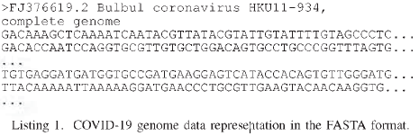
DATA MODELING
Data Acquisition:
The human genome data from the COVID-19 dataset is collected from NCBI. The size is around 3GB. The original human genome data from the COVID-19 dataset are organized in the FASTA format. A sample of the dataset is shown.
The FASTA format is a text-based format containing either nucleotide sequences or peptide sequences in which single-letter codes are used to describe base pairs or amino acids. An order in FASTA format starts with a single-line, accompanied by a series of sequence data.

Slide 8
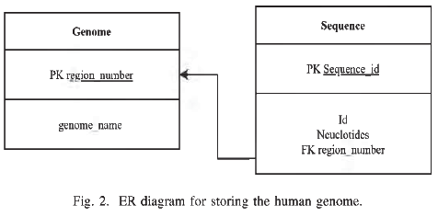
DATA MODELING
Data Manipulation:
MySQL:
For MySQL data modeling, we designed two tables namely Genome and Sequence using the dataset. In the Genome table, region_number is the primary key, and the genome_name field fills with ”HumanGenome” string. For the Sequence table, Sequence_id is the primary key, and region_number applies as a foreign key. Also, there are other fields like Id and Nucleotides. The Id field contains a unique value for an individual region, and the Nucleotides field holds a series of characters representing a nucleotide.

Slide 9
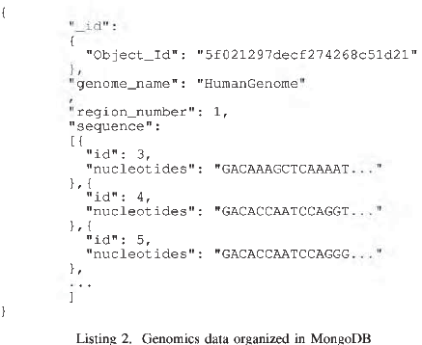
DATA MODELING
MongoDB:
In the case of MongoDB, data stored as JSON format. Instead of an external table, this extensive list of human genome data was stored in a single document.Here the id field carries a different value for a unique region, and the nucleotides field holds a string that describes a nucleotide sequence.

Slide 10
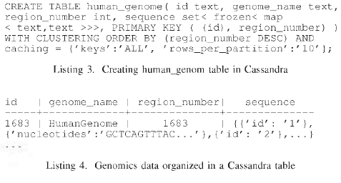
DATA MODELING
Cassandra:
In the case of Cassandra, we have created a table named human_genome for storing the human genome data from COVID-19 dataset.

Slide 11
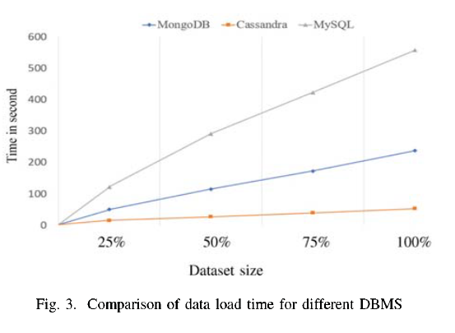
EXPERIMENTAL RESULTS
Data Load Time:
We have compared data load time for MySQL, MongoDB, and Cassandra.
Cassandra performs better than other DBMS, and MySQL has taken much time and performs worse among these three.

Slide 12

EXPERIMENTAL RESULTS
Query time:
MySQL, MongoDB, and Cassandra have their query syntax.
Three standard queries are performed using these DBMS. In every database, at the time of performing a query, we calculate the total time needed for that operation.
In the case of MySQL, we have to join two tables, namely Genome and Sequence, for retrieving name and nucleotides using region number and sequence id.

Slide 13


EXPERIMENTAL RESULTS
In MongoDB, we have retrieved all the information using name, region number and sequence id from the human_genome table.
In Cassandra, we have retrieved all the data using region number and sequence id from the human_genome table.

Slide 14
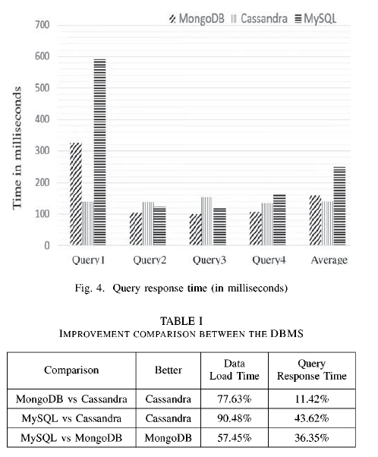
EXPERIMENTAL RESULTS
The query syntax of MongoDB is simpler between this three DBMS. MySQL query syntax is more complicated than the other two. Moreover, for Cassandra, we have to use ALLOW FILTERING for retrieving data. We have compared data query time for MySQL, MongoDB, and Cassandra in milliseconds.

Slide 15
CONCLUSION
We analyzed the query performance of tremendous amounts of datasets of the human genome data from the COVID-19 dataset in SQL and NoSQL DBMS.
We used MySQL for SQL DBMS and Cassandra and MongoDB for NoSQL DBMS.
We show a comparison in the case of data load time where Cassandra performs well. In the case of MySQL, we have to join two tables, and its operations become extensive. MongoDB’s query seemed pretty straightforward, small, and easy to operate. Cassandra’s performance shows the best among the three query performance, and its query syntax is also simple.
Finally, we analyzed Cassandra and MongoDB performed well comparing to MySQL in the case of unstructured data.

Slide 16
References
Dataset:-https://www.ncbi.nlm.nih.gov/datasets/coronavirus/genomes
A. Lakshman and P. Malik, “Cassandra: a decentralized structured
storage system,” ACM SIGOPS Operating Systems Review, vol. 44, no. 2,
pp. 35-40, 2010.
J. Dean and S. Ghemawat, “Mapreduce: simplified data processing on
large clusters,” Communications o f the ACM, vol. 51, no. 1, pp. 107-113,
2008.
P. Zikopoulos, C. Eaton et al., Understanding big data: Analytics fo r
enterprise class hadoop and streaming data. McGraw-Hill Osborne
Media, 2011.

Slide 17
THANK YOU

